Slide 1
Internet usage control using access control techniques

Slide 2
Problem
On a network infrastructure, there are 200 users. All the users access internet through a Cisco router. It was observed that the internet usage was very high which created problems like slow internet, expensive internet bills etc. To solve the problem, the network has to be redesigned which would allow only browsing traffic and all other traffic bound to the internet like FTP, Skype, etc should be blocked.

Slide 3
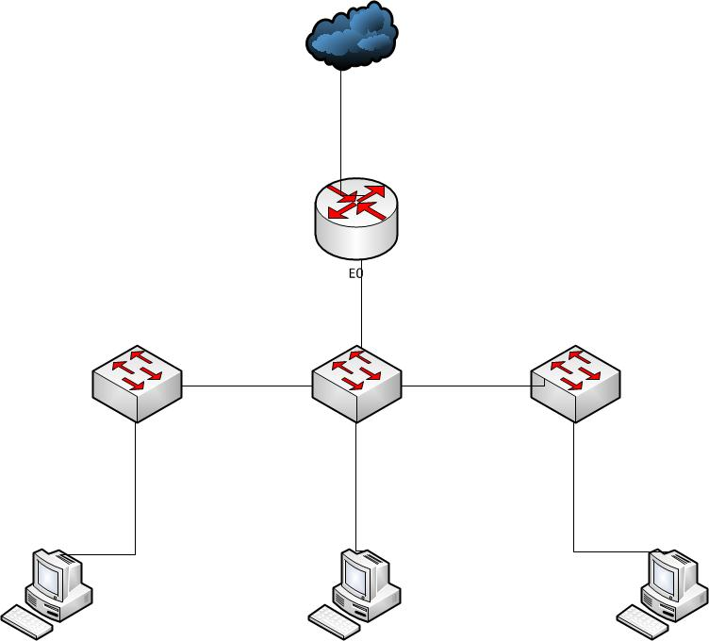
Network Topology Diagram.

Slide 4
TCP/IP addressing
The IP address of the LAN interface of the router is configured with the IP address 192.168.1.1
The users are configured with the IP address starting from 192.168.1.2 – 192.168.1.201.
The default gateway of users on the PC is configured with the IP address 192.168.1.1.

Slide 5
Network design strategy
Web browsing traffic would comprise of the protocols http, https and dns. http and https is used by browsers and dns is used for resolving website names into IP address.
Without DNS, name resolution would fail and browsing would not work.
An access list is configured on the E0 interface as inbound which would allow only the protocols listed above and all other traffic is blocked.

Slide 6
Router Configuration
An extended ACL is configured on the E0 interface as inbound, the detail of which is shown below.
Router(config)# #access-list 101 permit tcp 192.168.1.0 0.0.0.255 any eq 80
Router(config)# #access-list 101 permit tcp 192.168.1.0 0.0.0.255 any eq 443
Router(config)# #access-list 101 permit udp 192.168.1.0 0.0.0.255 any eq 53
Router(config)#interface FastEthernet 0/0
Router(config-if)#ip access-group 101 in

Slide 7
Router Configuration Explained
The first line configures the ACL to allow TCP port 80 for http communication
The second line configures the ACL to allow TCP port 443 for allowing https communication
The 3rd line configures the ACL to allow TCP port 443 for allowing https communication
The 4th line goes to the interface of the router

Slide 8
Router Configuration Explained
The 5th line applies the ACL as inbound.
The implicit deny functionality of Cisco ACL would ensure that all other protocols are denied automatically.
The configurations would ensure that only http, https and dns traffic is allowed from the network 192.168.1.0/24 to the E0 interface through which packets bound for the internet travel.
This would ensure that users would be unable to access any other type of traffic apart from the protocols listed above.

